Slide 1
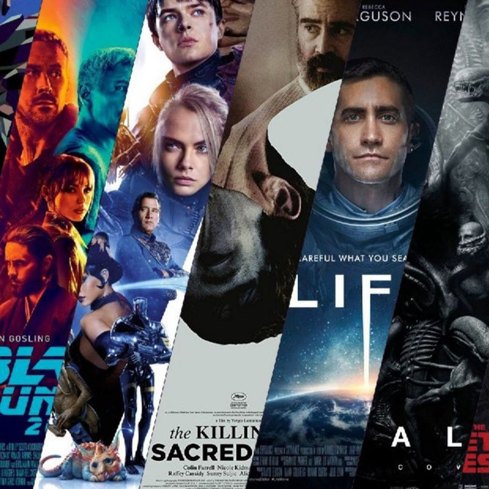
MovieApp
(or Popcorn)

Slide 2

MOVIES IS A PART OF OUR LIFE
Everyone watches cinema.
Relax us
Inspire us
Entertain us
Take us to any place in the world

Slide 3


Movie platform
We all know KinoPoisk and IMDb.
People search in there info about movie and there are functions like upcoming movies and articles about movies and following movie list. We wanted to make our OWN prototype.

Slide 4
What problem does app solve?
Recommends you movie
Has list of movies: best of 2019 (year) and etc.
Can have your own account, where you can create list of movies (like watch later, favorites)
Search your desired movie
Noticifications (get movie updates, news, app updates)

Slide 5
About app
Made for CSS 216 - Mobile Programming
Written in Dart (Flutter).
Github link: github.com/sdu-mp-21/MovieApp

Slide 6
About app
Goal: do watching movies easier and more comfortable, save which movies you will watch or you have watched.
Target audience: all age

Slide 7
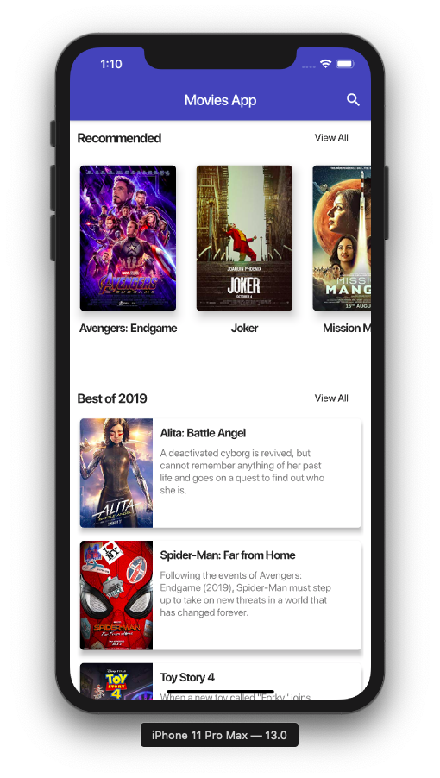
STRUCTURE OF APP
MAIN PAGE
Recommended
Best of 2019
Search

Slide 8
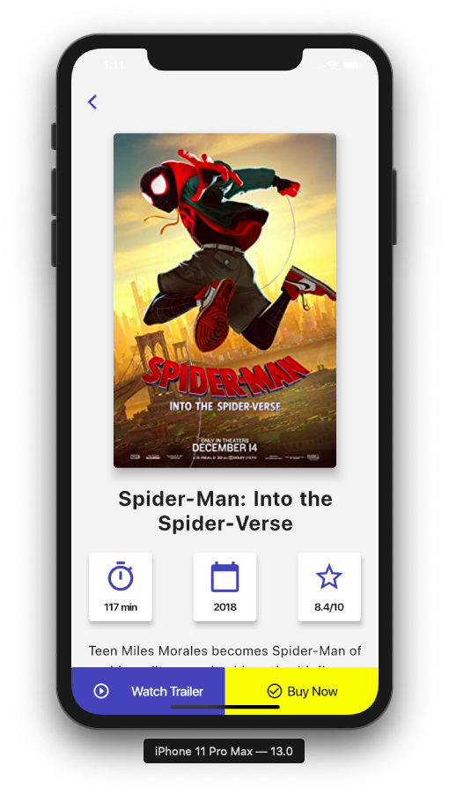
STRUCTURE OF APP
MOVIE DETAILS
Watch trailer
Buy now
Info about movie

Slide 9
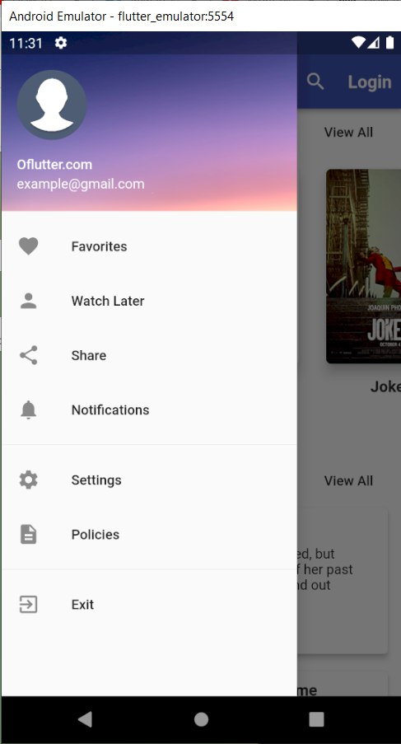
STRUCTURE OF APP
PROFILE PAGE
Favourites
Watch later
Notifications
Settings

Slide 10
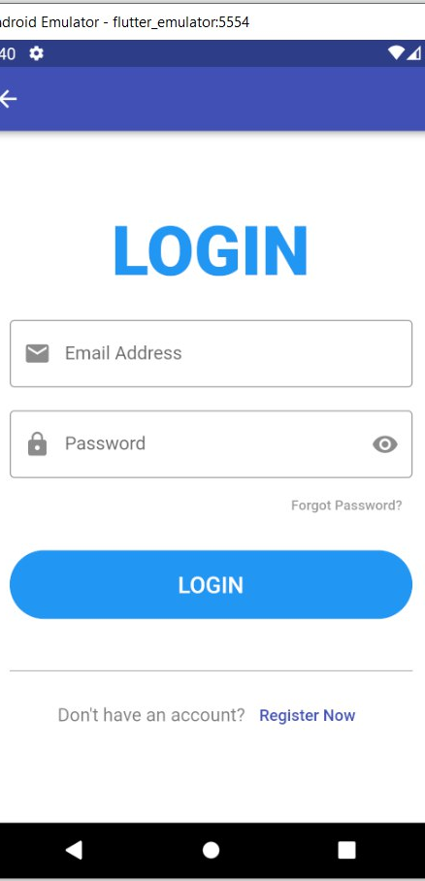
STRUCTURE OF APP
LOGIN PAGE

Slide 11
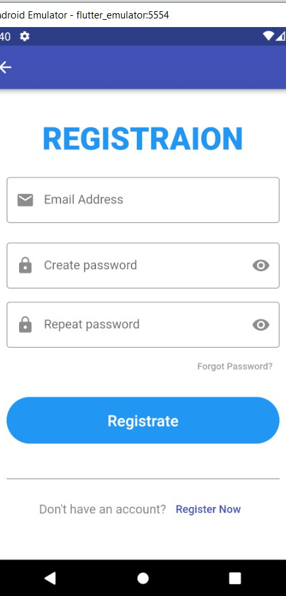
STRUCTURE OF APP
REGISTRATION PAGE

Slide 12
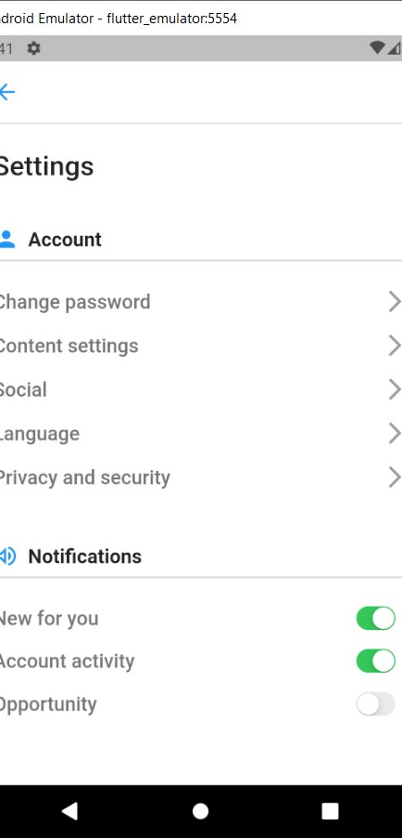
STRUCTURE OF APP
SETTINGS PAGE
• CHANGE PASSWORD
• CHANGE LANGUAGE
• NOTIFICATION SETTING

Slide 13
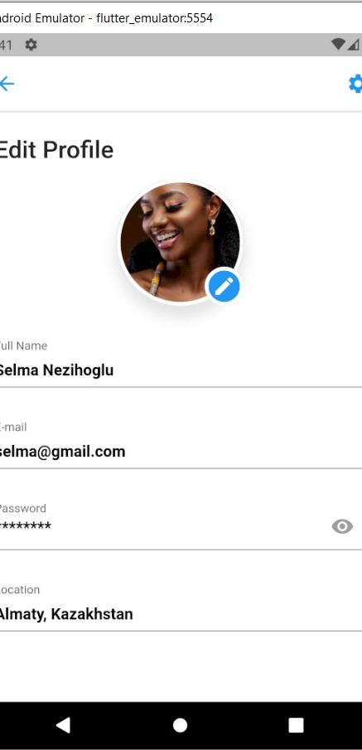
STRUCTURE OF APP
EDIT PROFILE
• EDIT ACCOUNT INFO

Slide 14
DEMO OF APP

Slide 15
HandAndBrain
Olzhas Samatov
Selma Nezihoglu
Nurmukhamed Nurkamal
Ulday Turganbayeva
Tamirlan Rassylbek

Slide 16
Thank you for
attention!

